Slide 1


Domotic Modules for smart home & co

Slide 2
The DOMIX Manifesto
DOMIX was created first and foremost for fun.
Fun, in the original sense: curiosity, experimentation, learning, and the joy of building something that works because you understand it.
DOMIX is not a product.
It is not a startup.
It is not a competitor.
It is a research-driven, open, modular automation platform built by interest, not by market pressure.

Slide 3
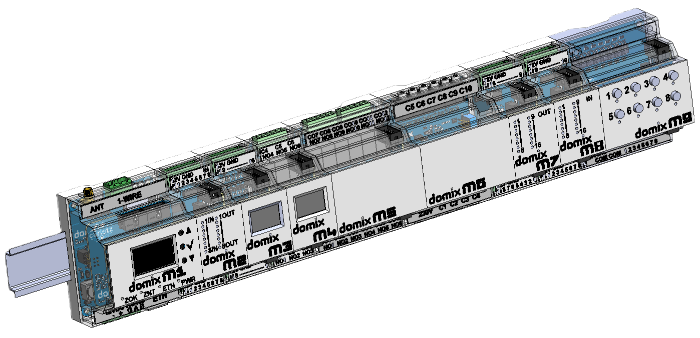
The DOMIX Manifesto
1. Open by Design
2. No Competition with Industrial Systems
3. Research, Not Certification
4. Modular or Nothing
5. Cabinet-Oriented, Low-Voltage Only
6. Ethernet First, Always
7. Open Ecosystem Integration
8. Zigbee as a First-Class Citizen
9. Fully Customizable by Design
10. Built for People Who Want to Understand

Slide 4
Modular System Overview
DOMIX is a DIN-rail modular automation system designed around a centralized core controller and a set of specialized functional modules.
At the heart of the system is the DOMIX M1 Core Module, which manages logic, communication, and coordination.
All other modules are connected to M1 through a multi-drop I²C expansion bus, forming a scalable and deterministic automation backbone.
Each module is designed to occupy a defined number of standard DIN units, allowing clean electrical cabinets and predictable layouts.

Slide 5
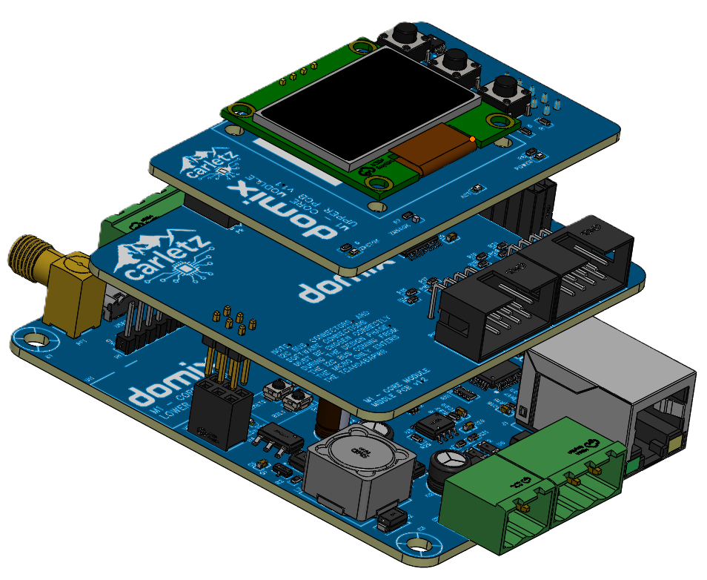
Core Communication Concept
- M1 acts as the I²C Master
All other modules act as I²C Slaves
Each module has:
- A unique I²C address
- Its own local intelligence (I/O handling,
protection, signal conditioning)
The bus is optimized for:
- Short to medium distances inside electrical cabinets
- High reliability
- Low complexity

Slide 6
I2C address as first decision
I2C Address must be decided before trying to add modules!
A configuration is valid on a single I2C bus if all the following conditions are met:
(M2 + M5 + M7 + M8 + M9) ≤ 8
(M3 + M4 + M6 + M9) ≤ 8
(M3 + M6) ≤ 4 (ADS1115 limit)
Module | 0x20–0x27 | 0x38–0x3F | ADS1115
M2 | 1 | 0 | 0
M5 | 1 | 0 | 0
M7 | 1 | 0 | 0
M8 | 1 | 0 | 0
M3 | 0 | 1 | 1
M4 | 0 | 1 | 0
M6 | 0 | 1 | 1
M9 | 1 | 1 | 0

Slide 7
DIN Rail Form Factor Strategy
This approach ensures:
- Mechanical consistency
- Easy cabinet planning
Clear separation of logic,
sensing, and actuation
Module | Function | DIN Width
M1 | Core / Gateway | 4 modules
M2 | Digital I/O | 2 modules
M3 | Door & Window Contacts | 2 modules
M4 | 6-Relay / Shutter | 2 modules
M5 | 12-Relay / Shutter | 4 modules
M6 | Energy Meter (Clamp Meter) | 4 modules
M7 | Digital Output | 2 modules
M8 | Digital Input | 2 modules
M9 | Sprinkler | 4 modules

Slide 8
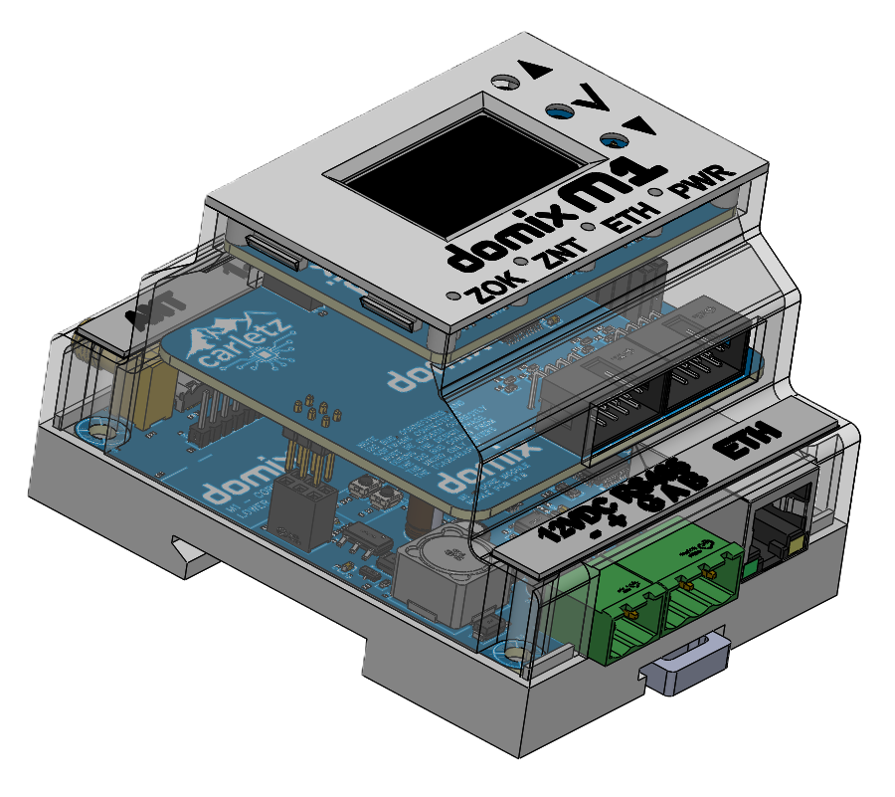
M1 – Core Module (4 DIN Units)
The M1 Core Module is the brain of the DOMIX system.
Main responsibilities:
- System logic and automation rules
- Communication gateway
- I²C master controller
- Network and protocol translation
Key interfaces:
- Ethernet (W5500)
- Zigbee (CC2652-based module)
- RS485 (industrial fieldbus)
- I²C expansion bus
- Local display and buttons
M1 orchestrates all other modules and exposes the entire system to external platforms such as home automation servers or custom applications.

Slide 9
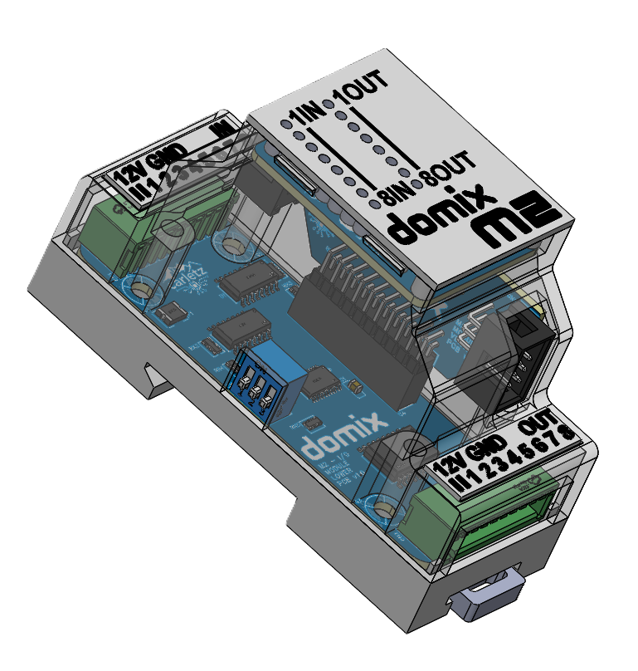
M2 – I/O Module (2 DIN Units)
The M2 module provides generic input and output capabilities.
Typical features:
- 8 Digital inputs (dry contact)
- 8 Digital outputs (low-power control)
Used for:
- Switch or similar
- Auxiliary controls
Generic automation tasks
Connections to power relay or contactors
I2C addressable by dip switch on left side for each module

Slide 10
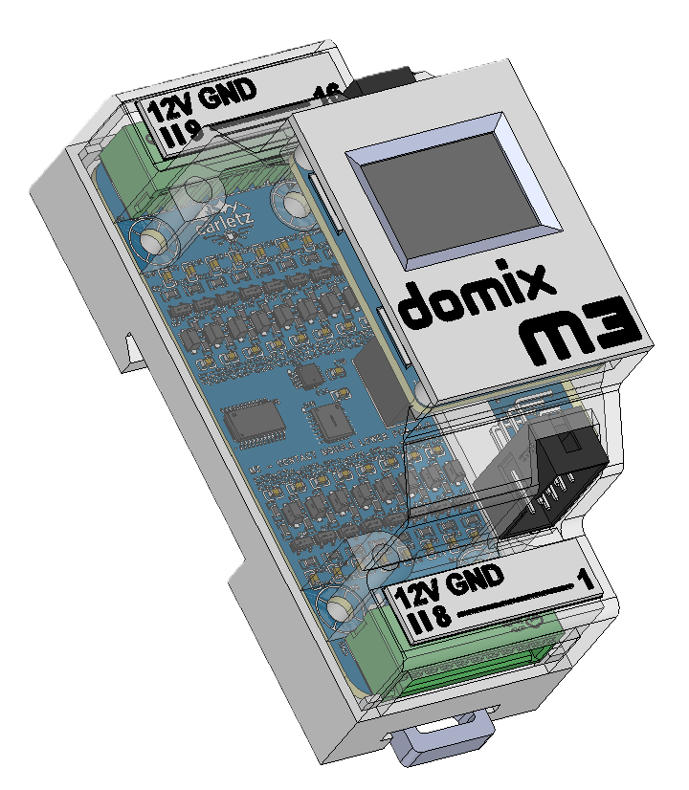
M3 – Contact Module (2 DIN Units)
The M3 module is optimized for door, window, and dry-contact monitoring.
Characteristics:
- 16 Isolated analog inputs
- Long cable compatibility
- Debounce and noise filtering
- Ideal for security and presence logic
Designed specifically for:
- Doors
- Windows
- Magnetic reed sensors
- Alarm contacts

Slide 11
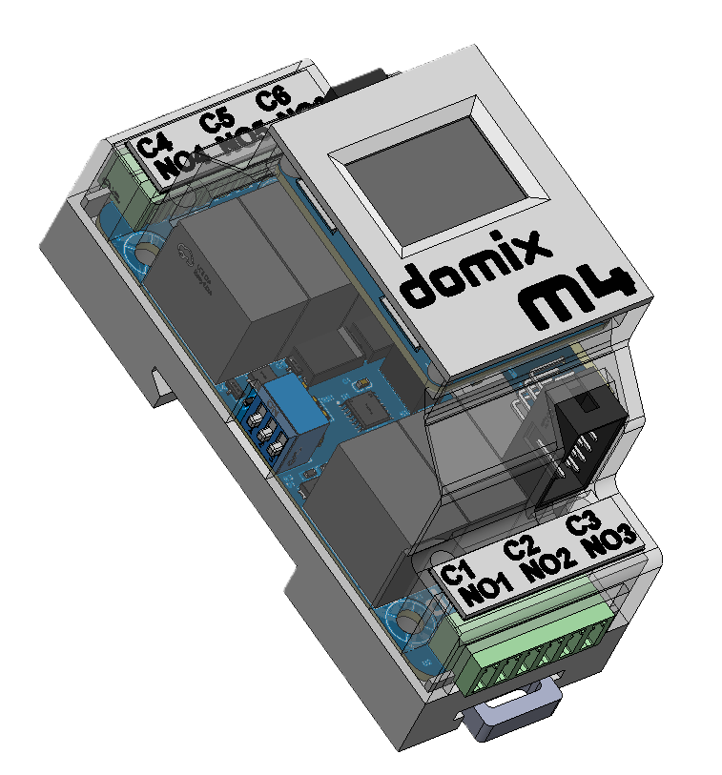
M4 – Relay Module (2 DIN Units)
The M4 module provides compact relay-based outputs.
Features:
- 6 electromechanical relays
- Suitable for:
- Lights
- Small loads
- Auxiliary actuators
Logical grouping for room-based automation
I2C addressable by dip switch on left side for each module

Slide 12
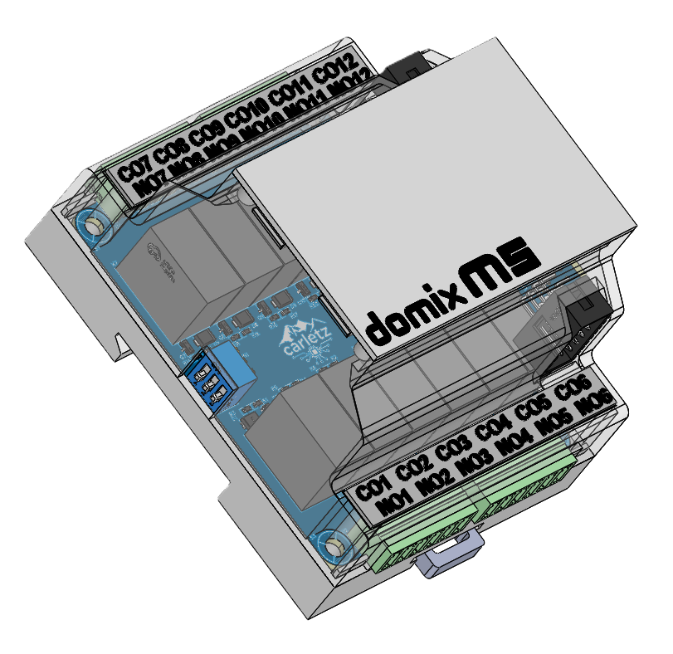
M5 – Relay Module (4 DIN Units)
The M5 module provides compact relay-based outputs.
Features:
- 12 electromechanical relays
- Suitable for:
- Lights
- Small loads
- Auxiliary actuators
Logical grouping for room-based automation
I2C addressable by dip switch on left side for each module

Slide 13
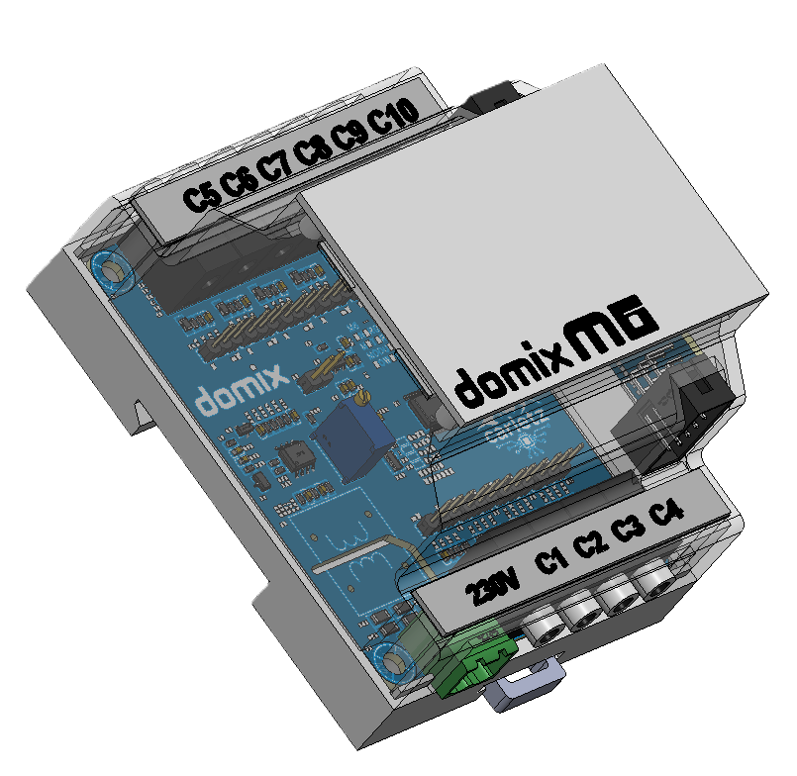
M6 – Energy meter (4 DIN Units)
The M6 module provides compact current reading.
Features:
- 10-channel current monitoring
Main Voltage reading
I2C addressable by dip switch on left side for each module

Slide 14
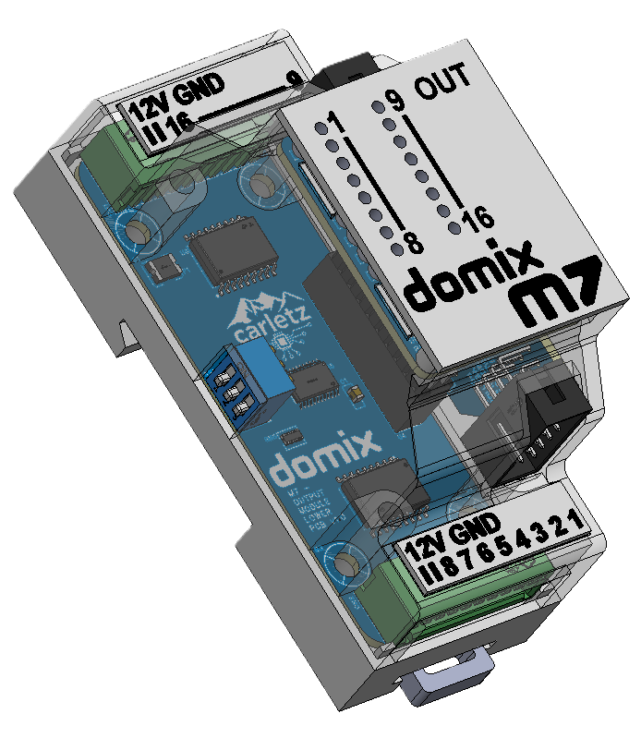
M7 – Output module (2 DIN Units)
The M7 module provides compact output possibilities.
Features:
16 output channels low voltage
I2C addressable by dip switch on left side for each module

Slide 15
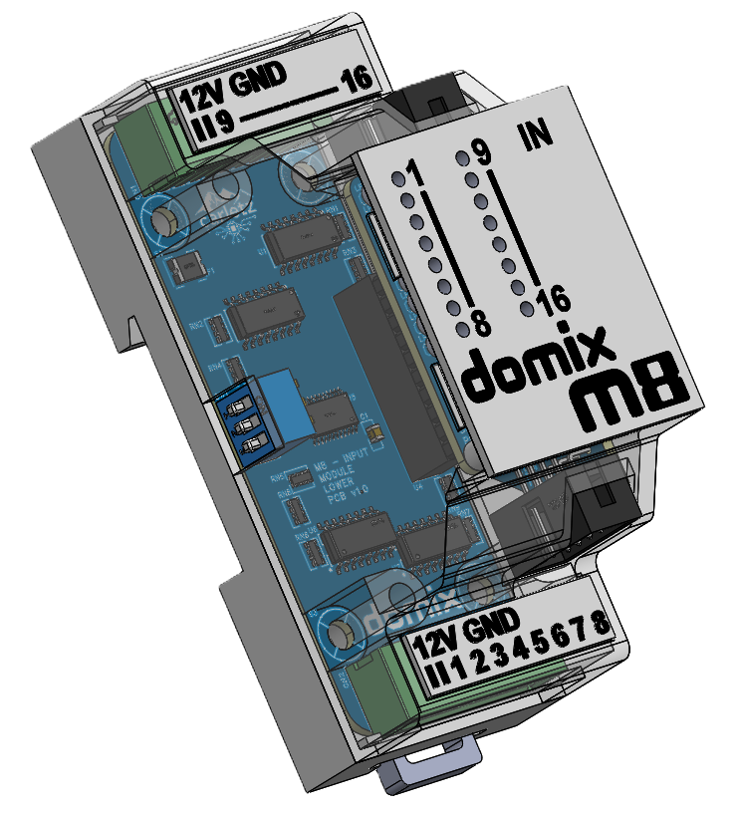
M8 – Input module (2 DIN Units)
The M8 module provides compact input possibilities.
Features:
16 input channels low voltage
I2C addressable by dip switch on left side for each module

Slide 16
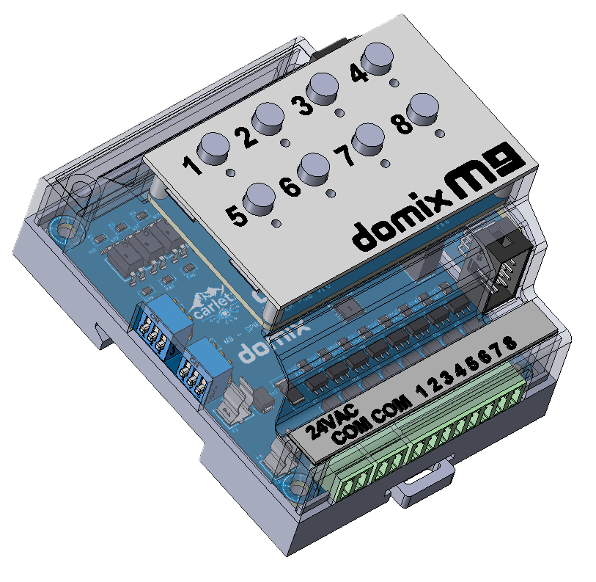
M9 – Sprinkler module (4 DIN Units)
The M9 module provides sprinkler possibilities.
Features:
8 sprinkler 24VAC valves output
8 manual commands
I2C addressable by dip switch on left side for each module

